Slide 1
Digital Twins (DT)
Differences between digital shadow, digital model, digital twin
Enclosing on a definition…
3 components: phyisical model, virtual model, communication services

Slide 2
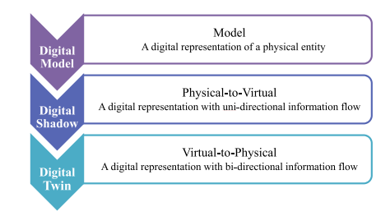
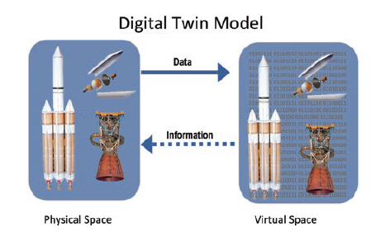
Differences between twins
DT components

Slide 3
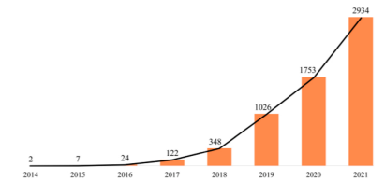
DT in literature - #1
Still a buzzword
Rising number of publications
Mostly non IT papers
Not really twins…
DT by year (Fei, Tao 2022)

Slide 5
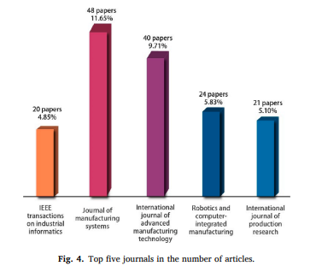
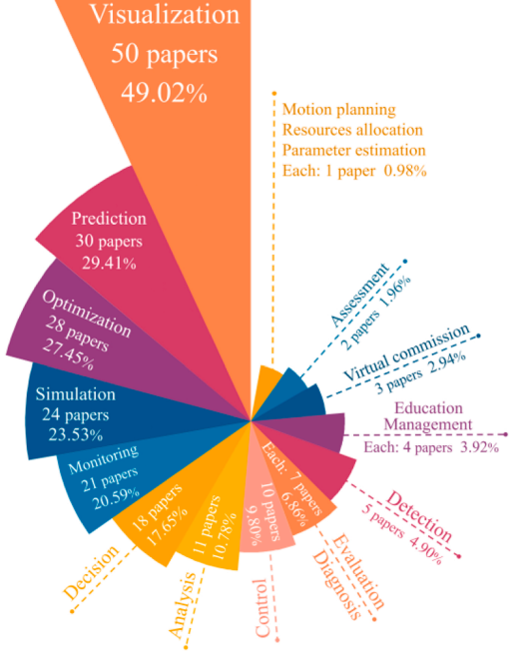
DT by journal (Fei, Tao 2022)
DT by goal (Fei, Tao 2022)

Slide 6
DT in literature - #2
Mostly manufacturing, smart cities, health domain
Still mostly application oriented, focused on visualization (e.g. Unity3D)
While concept of data as a core component is arising..
… Still left unconsidered in most research papers.
However, some standard models are emerging…
Most cited: Fei Tao, Univ. of Beijing

Slide 7
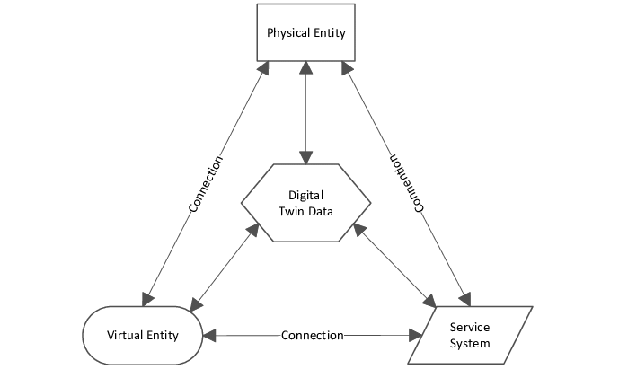
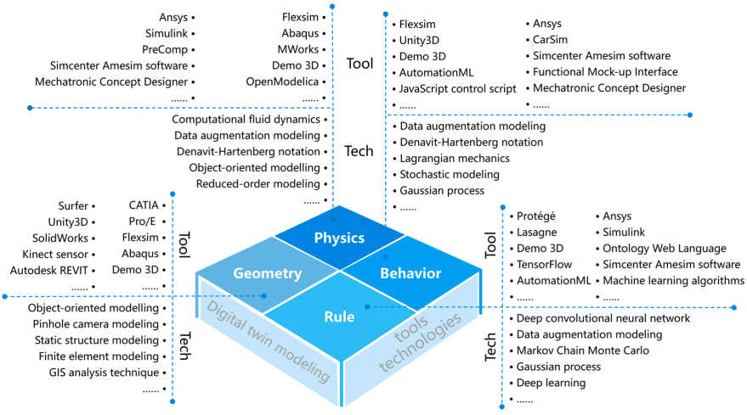
5-Dimensional DT (Fei, Tao 2020)
Virtual Entity architecture (Fei, Tao, 2020)

Slide 8
DT in industry
Azure Digital Twins
AWS IoT Twin Maker
Digital Twin Consortiumf

Slide 9
Azure Digital Twins
FIWARE like
Digital Twin Definition Language (DTDL) - JSON-LD/NGSI-LDgi
Offers interfaces to control the physical device (not supported)
Native support for Azure Data Explorer (Relational, time-series, ingestion & analytics)
Not clear if it facilitates or provides integration with Azure big data services.

Slide 10
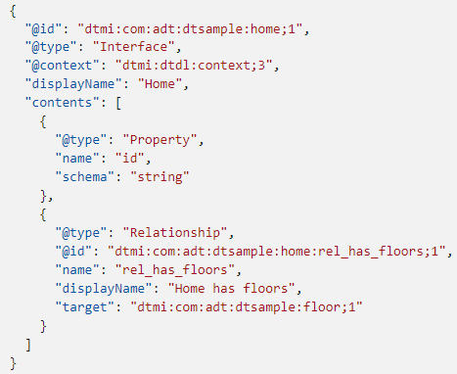
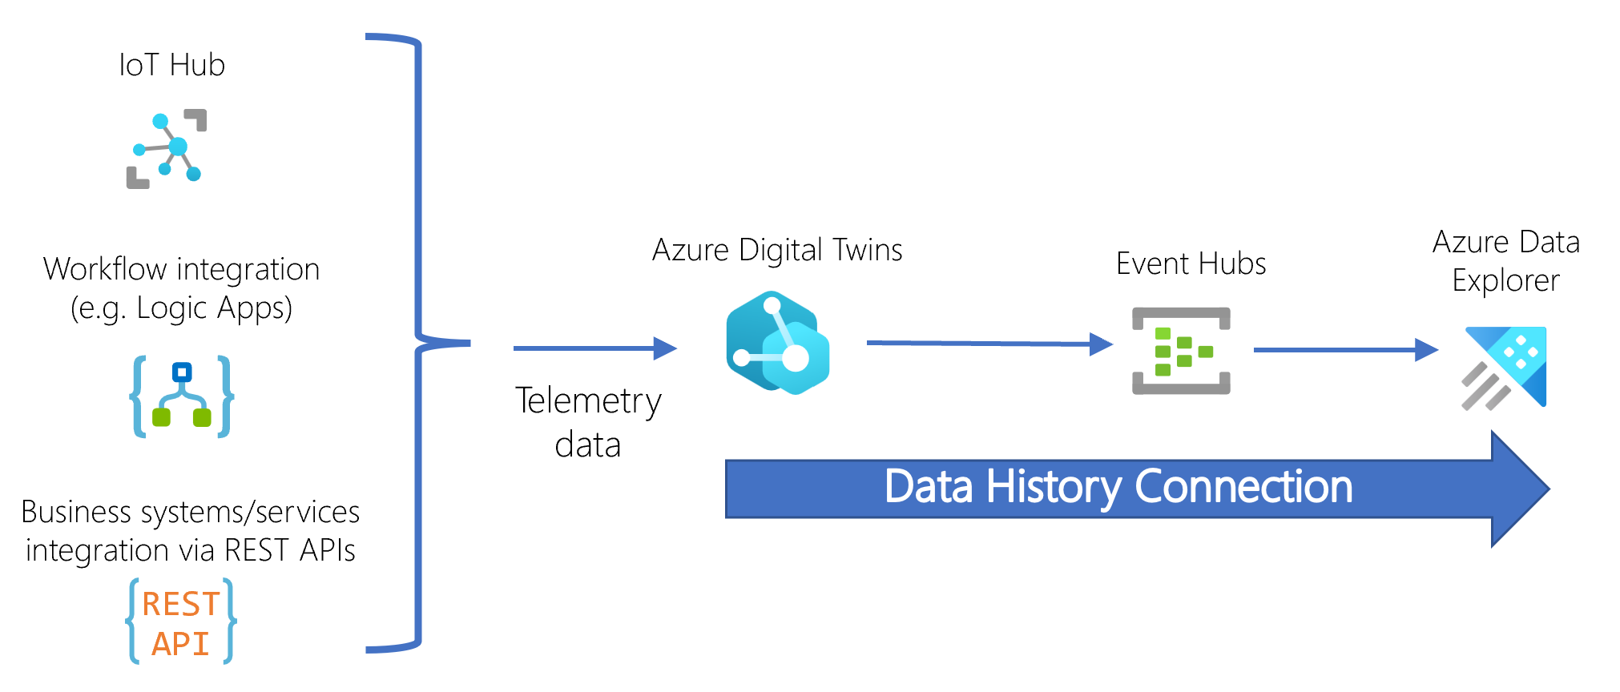
Example of DTDL
Azure DT Platform

Slide 11
AWS IoT Twin Maker
Similar to Azure Digital Twins (also JSON Entity-Component model)
Different JSON semantics
Also graph representation
Native support for Grafana, AWS IoT Site Wise (which leverages AWS Timestream, a time-series DB)

Slide 12
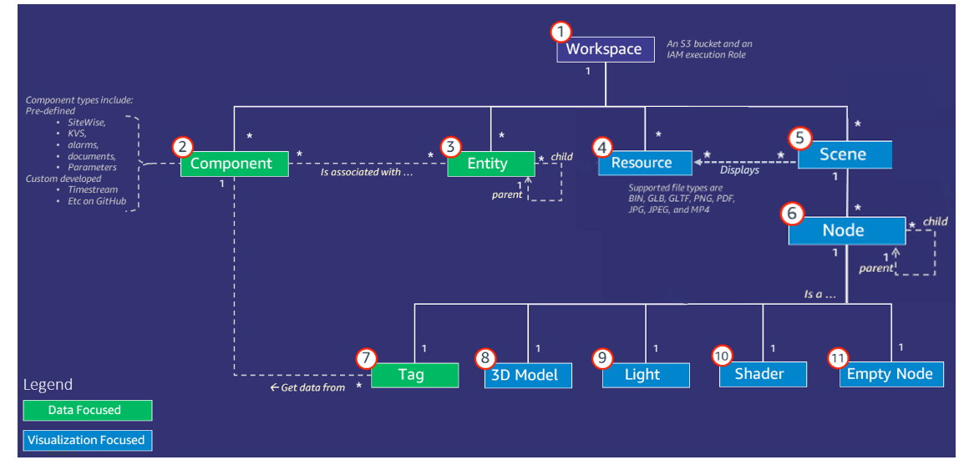
Component JSON documents that describe the connection between a data source and AWS IoT Twin Maker. They access external datasource via a Lambda function defined in the JSON
Each workspace is assigned an S3 Bucket
Key concept and components AWS IoT Twin Maker (documentation here)

Slide 13
DT Data Related Aspects

Slide 14
DT Data - Modeling
Focused on entities last state
In literature, wide spread of AutomationML, XML, etc.
Mostly graphs (too many connections between data)
Initially pure linked data and semantic graphs (RDF, ontologies)
New standards (JSON-LD, NGSI-LD) to seamelessly integrate semi-structured data, property graphs and semantic graphs (also supported by RDF)

Slide 15
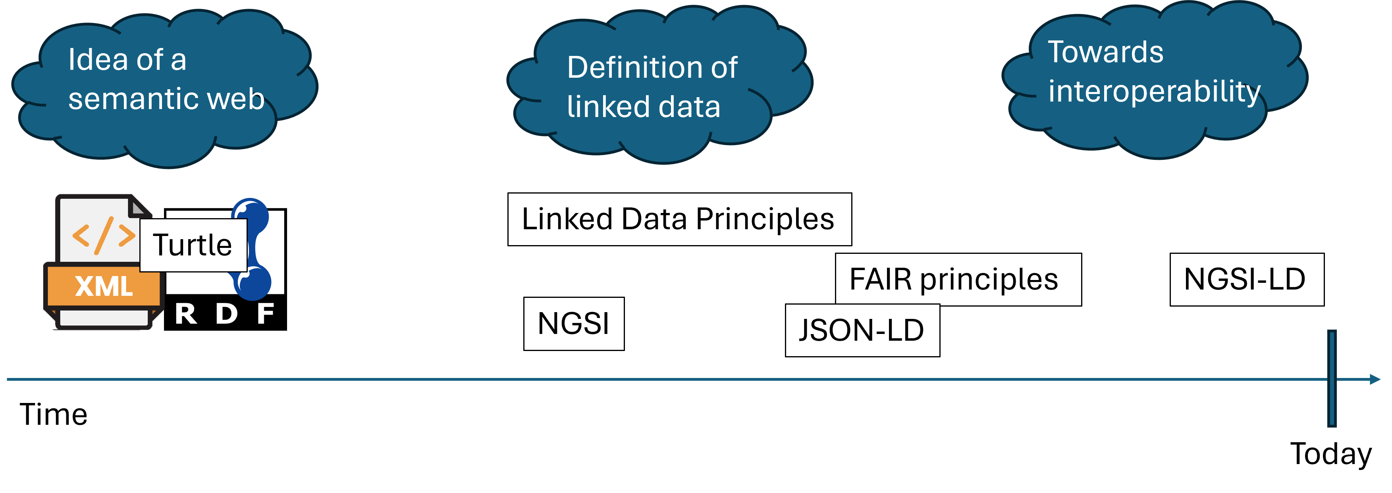
DT Data - A brief history
Simplified technology history

Slide 16
NGSI-LD (Next Generation Service Interface – Linked Data)
Evolution of NGSI v2, powered by FIWARE
Defines a metamodel and APIs (Swagger URL) for property graphs
“id” now must be an URN (or an URI HTTP)
The entity must have a “type” attribute which represent the class of the entity
The class must then be defined in the @context
@context implicitly includes the core @context of NGSI-LD:

Slide 17
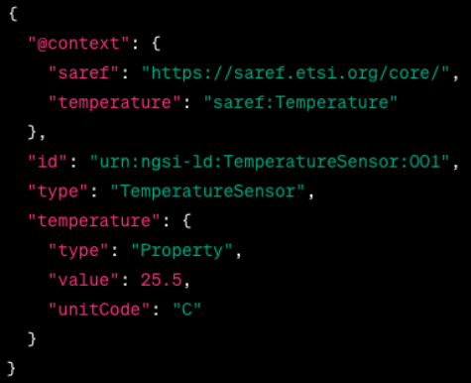
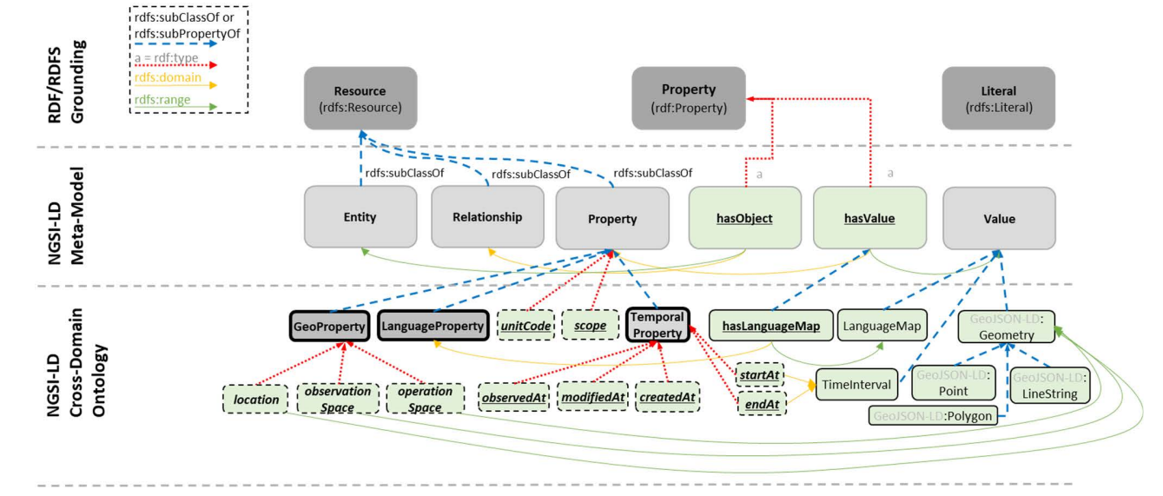
NGSI-LD Metamodel
NGSI-LD Entity Example

Slide 18
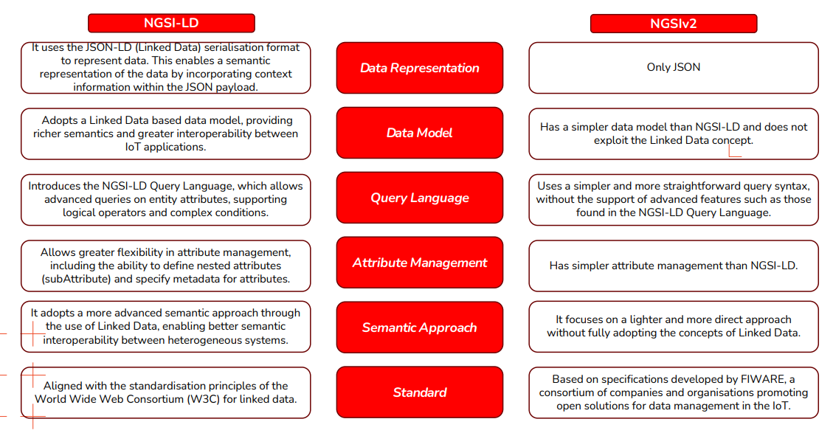
NGSI-LD vs. NGSIv2
Comparison NGSIv2 - NGSI-LD

Slide 19
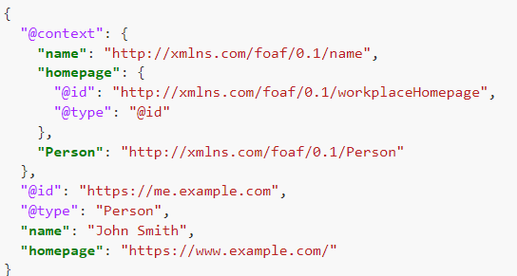
JSON-LD
Make JSON machine-readable again!
Defined to merge semantic data and commonly used JSON documents
Standard for encoding linked data
FIWARE is evolving as well… (Orion-LD)
JSON-LD Example

Slide 20
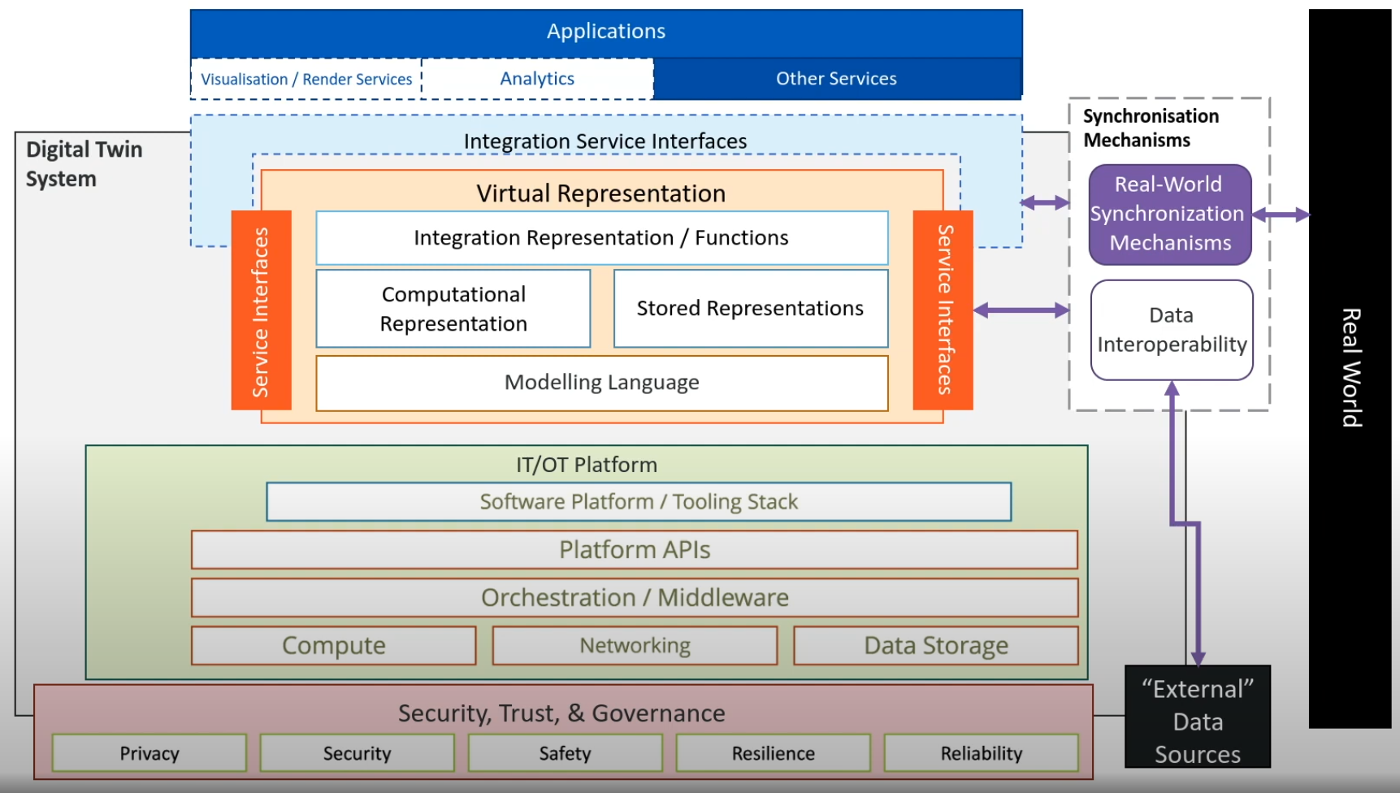
DT Data - Architectures
Most papers don’t even mention it!
When they do, they focus on entities last-state.
Is it really different from a Lambda-like big data architecture?
e.g. Digital Twin Consortium
Digital Twin Consortium Architecture

Slide 21
DT Data - Lifecycle
Something is starting to pop out
“Trash” literature ? (non IT academics, e.g. Dihan et. al., 2024)
Are we reinventing the wheel?

Slide 22
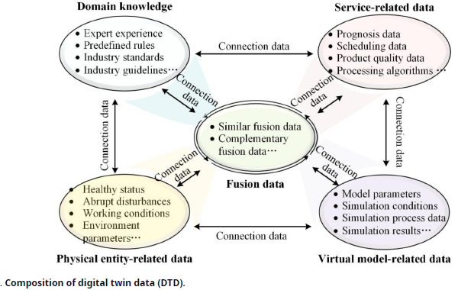
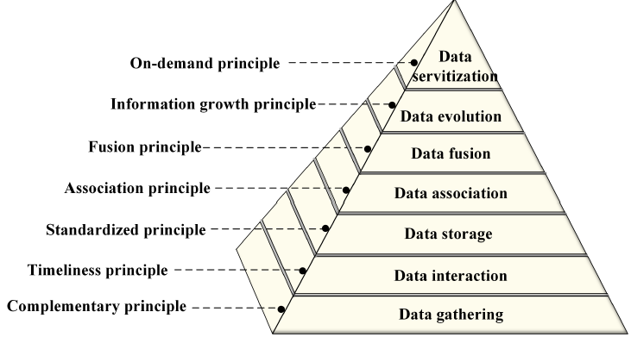
Digital Twin Data (Fei, Tao 2023)
Data Methodology (Fei, Tao 2023)

Slide 23
What next?
Data Architectures
Focus on historical data
Digital Twins Platforms (!!!)
Data modeling (on two different abstraction levels)
Meta-Models for historicized data in a DT (domain driven?)
Standardazing a wider concept (e.g. interoperability between different DT)
Methodology
Watering Digital Twin
P.h.D. Proposal timeline

Slide 24
Carbonaro 17/09
Loro usano property-knowledge graph
Open word assumption: solo in AND …
CONSTRUCT (è quello che utilizzo per le “implementedBy”)
Hanno necessità di separare ciò che è corrente e ciò che è passato.
SWRL + SPARQL
Utilizzano GraphDB (hanno provato)
Dov’è il confine tra ciò che è nuovo e ciò che è passato? Tradeoff tra quanto velocemente cambiano le cose? Un sensore che cambia ogni 10ms non posso storicizzare.

Slide 25

Benchmark workload
Aspects
Dimensions
Spatial
Temporal
Workload:
Operational
Analytical
Mode:
Online (?)
Offline (?)
From IoTAbench, ICPE 2015
Total readings: counts the total number of readings (i.e., rows) for the given time period.
Total consumption: sums the resource consumption for the given time period.
Peak consumption: Create a sorted list of the aggregate consumption in each ten minute interval in the given time period.
Top consumers: create a list of the distinct consumers, sorted by their total (monthly) consumption.
Time of Usage Billing: calculate the monthly bill for each consumer based on the time of usage.
From SmartBench, VLDB 2020
IoTABench data model

Slide 26
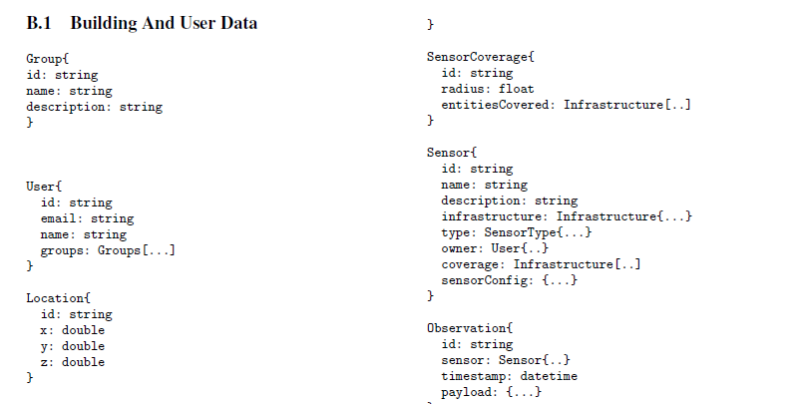
Coverage (s ∈ Sensors): returns the location of a given sensor s.
InverseCoverage(L, τ), where L is a list of locations, and τ is a sensor type: lists all sensors that can generate observations of a given type τ that can cover the locations specied in L.
Observations (S ∈ Sensors, $t_{b}$, $t_{e}$): selects observations from sensors in the list of sensors S during the time range [$t_{b}$; $t_{e}$].
C Observations (τ , cond, $t_{b}$, $t_{e}$): selects observations generated by sensors of given type τ in the time range [$t_{b}$; $t_{e}$] that satisfy the condition cond.
Statistics(S ⊆ Sensors, A, F, $t_{b}$, $t_{e}$): retrieves statistics (e.g., average) based on functions specifed in F during the time range [$t_{b}$; $t_{e}$]. The statistics are generated by firstrst grouping the data by sensor, and further by the value of the attributes in the list A
Trajectories($t_{b}$, $t_{e}$, $l_{b}$, $l_{e}$): retrieves the names of users who went from location $l_{b}$ to location $l_{e}$ during the time interval [$t_{b}$; $t_{e}$]
CoLocate($u$ ∈ Users, $t_{b}$, $t_{e}$): retrieves all users who were in the same Location as user $u$ during the specifoed time period.
TimeSpent($u$ ∈ Users, η, tb, te): retrieves the average time spent per day by subject $u$ in locations of type η,
Continuous Query(τ, α, β): retrieves, after every α seconds (hop size), the minimum, maximum, and average occupancy levels of locations of type τ in the last β seconds (window size).

Slide 27
Other benchmarks
Spatial DB
The SEQUOIA 2000 Storage Benchmark, SIGMOD 1993
Building a ScalableGee-SpatialDBMS: Technology, Implementation,and Evaluation SIGMOD 1997
Time Series DB
TS-Benchmark: A Benchmark for Time Series Databases, ICDE 2021
SciTS: A Benchmark for Time-Series Databases in Scientific Experiments and Industrial Internet of Things, International Conference on Scientific and Statistical Database Management 2022 (SSDBM)
TSM-Bench: Benchmarking Time Series Database Systems for Monitoring Applications, VLDB 2023
Spatio-Temporal
BerlinMOD: A benchmark for moving object databases, VLDB Journal 2009
Benchmarking moving object functionalities of DBMSs using real-world spatiotemporal workload, International Conference on Mobile Data Management 2022
Performance Evaluation of MongoDB and PostgreSQL for spatio-temporal data, EDBT/ICDT Workshops 2019
How to manage massive spatiotemporal dataset from stationary and non-stationary sensors in commercial DBMS?, Knowledge and Information Systems 2024

Slide 28
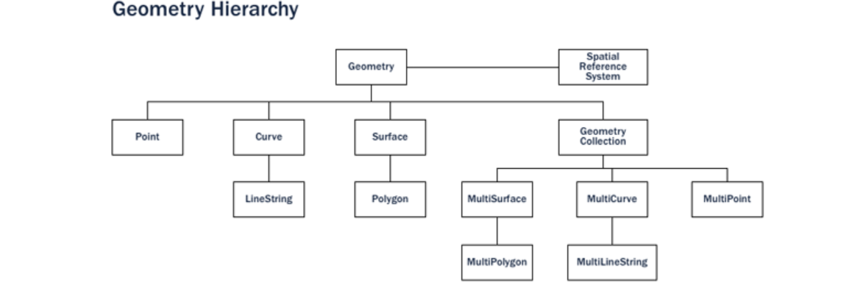
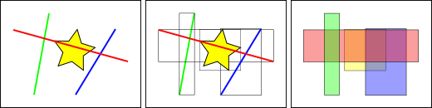
PostGIS
Spatial Functions
Routing. With pgRouting and road data you can find optimal routes and do different network analytics;
Polygon skeletonization. This function enables you to build the medial axis of a polygon on the fly;
Geometry subdivision. Dividing your geometries for further processing can significantly speed up your processes;
Clustering. Find clusters and patterns from your data. With the AI hype at peak, the k-means might be even more interesting for some than before…
Indexing
Indexes have to perform quickly in order to be useful. So instead of providing exact results, as B-trees do, spatial indexes provide approximate results. The question “what lines are inside this polygon?” will be instead interpreted by a spatial index as “what lines have bounding boxes that are contained inside this polygon’s bounding box?”
The most common implementations are the R-Tree and Quadtree (used in PostGIS), but there are also grid-based indexes and GeoHash indexes implemented in other spatial databases.
The way the database efficiently answers the question “what lines intersect the yellow star” is to first answer the question “what boxes intersect the yellow box” using the index (which is very fast) and then do an exact calculation of “what lines intersect the yellow star” only for those features returned by the first test.
PostGIS Geometry Hierarchy
BBox Example

Slide 29
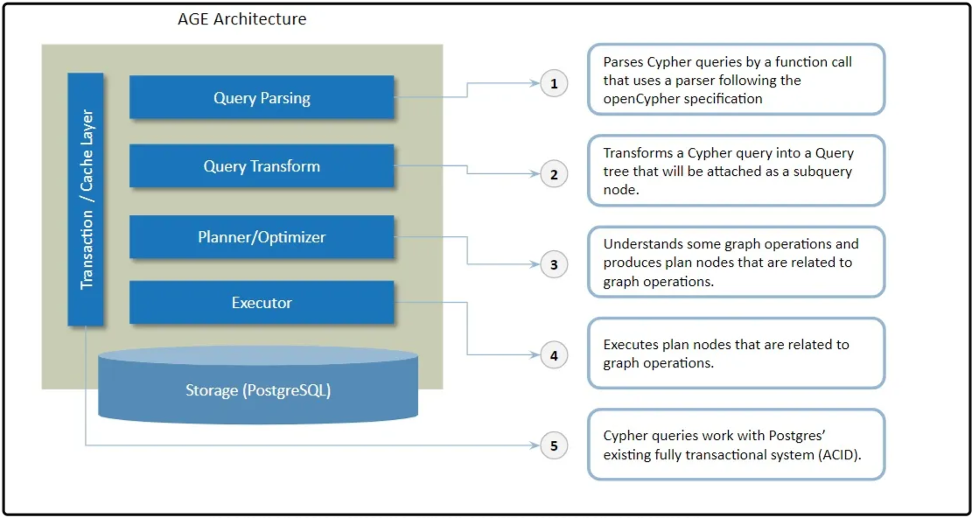
Apache AGE
Extends PostgreSQL with graph semantics
No graph data model!
Wrapper upon PostgreSQL relational storage
A table for each node/vertex label
Setup
Create and load AGE extension
CREATE EXTENSION IF NOT EXISTS age; LOAD 'age';
Allow user access to such path
SET search_path = ag_catalog, "$user", public;
Create a node A
SELECT * FROM cypher('test_graph', $$ CREATE (:label {property:"Node A"}) $$) as (v agtype);
Create a node B
SELECT * FROM cypher('test_graph', $$ CREATE (:label {property:"Node B"}) $$) as (v agtype);
Create an edge between node A and node B
SELECT * FROM cypher('test_graph', $$ MATCH (a:label), (b:label) WHERE a.property = 'Node A' AND b.property = 'Node B' CREATE (a)-[e:RELTYPE {property:a.property + '<->' + b.property}]->(b) RETURN e $$) as (e agtype);
Select those edges
SELECT * from cypher('test_graph', $$ MATCH (V)-[R]-(V2) RETURN V,R,V2 $$) as (V agtype, R agtype, V2 agtype);
Apachce AGE under the hood architecture

Slide 30
Spatio Temporal DBMS
A Survey on Spatio-temporal Data Analytics Systems, ACM Surveys 2022
Categorizes spatio-temporal DBMSs in groups:
Spatial DBMS:
RDBMS
No-SQL DBMS
Big data spatio-temporal processing infrastructures
Hadoop based infrastructures
Spark based infrastructures
No-SQL infrastructures
Programming languages
DASK
RAPIDS
Spatial DBMS

Slide 31
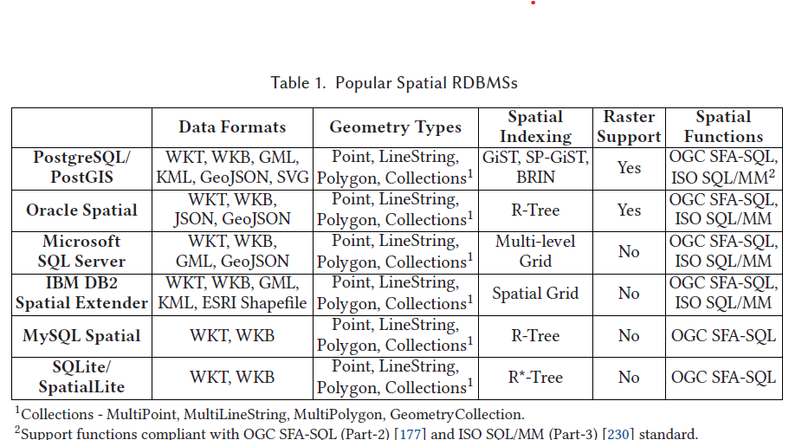
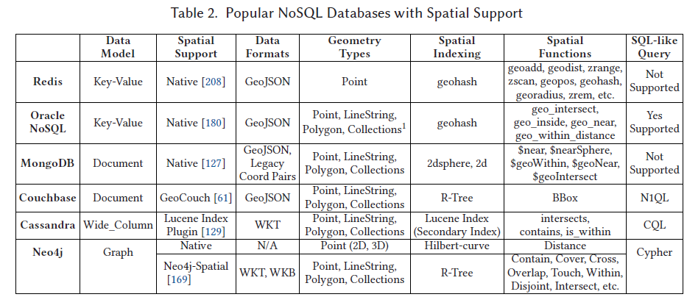
RDBMS
Due to the I/O bottleneck, lack of parallelism and scalability, the performance of these systems deteriorated with the increasing volume of data.
PostgreSQL -> PostgresXL
MobilityDB was developed as an extension of PostgreSQL/PostGIS, providing support for storing and querying moving objects data (trajectory). This support includes spatio-temporal data types, indexing techniques, and query operations. Recently, MobilityDB emerged as a distributed system by integrating with Citus for processing massive trajectory data
No-SQL DBMS
Currently, the spatial support of NoSQL databases lacks available spatial operations compared to spatial RDBMSs.
Taxonmy of RDBMS for spatio-temporal data
Taxonmy of No-SQL DBMS for spatio-temporal data

Slide 32
RDBMS vs NoSQL for Spatial Data
Performance Evaluation of MongoDB and PostgreSQL for Spatio-temporal Data, EDBT/ICDT Workshops 2019

Slide 33
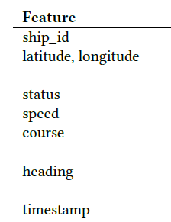
Dataset Size
11 GB, 43 288 vessels, 146.491.511 records
MongoDB: 116 GB
PostgreSQL: 32 GB
Dataset Schema

Slide 34
MongoDB stores data in GeoJson format, each record has many extra characters + unique auto created ObjectId. PostgreSQL ingests data as CSV, with adding the_geom column that contains the POINT geometries for latitude and longitude.
Results
The results show that PostgreSQL with the PostGIS extension, outperforms MongoDB in all queries.
Big spatio-temporal data processing infrastructures

Slide 35
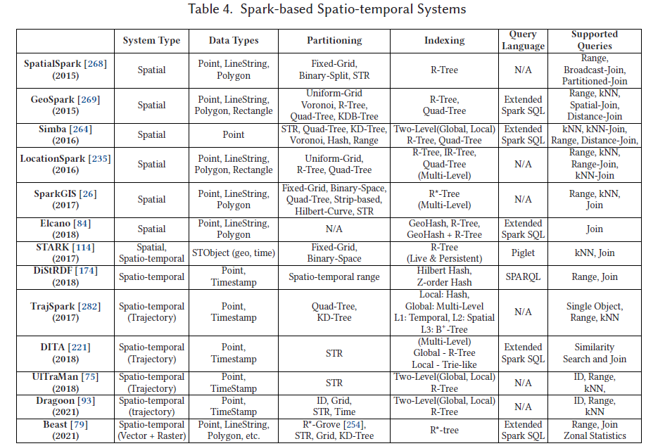
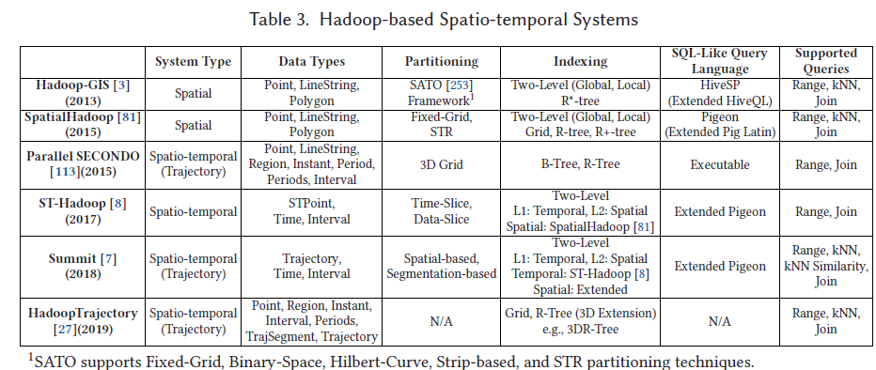
Hadoop based
Due to the lack of spatio-temporal data types, partitioning, and indexing techniques, Hadoop-GIS & SpatialHadoop suffer querying spatio-temporal datasets
ST-Hadoop was developed by considering attributes of discrete spatio-temporal point data, not trajectory data. So data might be wrong-sharded when indexed.
Summit is an extension of ST-Hadoop to include data types, partitioning and indexing techniques, and operations, for processing trajectory data.
Bakli et al. [27] have proposed HadoopTrajectory, which adds a diverse set of data types and operators into the core of Hadoop to store and process trajectory data.
Spark-based
First five spatial data processing solutions are not fully compliant with the ISO standard and OGC specifications.
STARK integrates spatio-temporal support to Spark RDDs
DiStRDF is a distributed system for processing spatio-temporal RDF data; however, these last two focus on discrete data points and not trajectories.
TrajSpark does not have any support for SQL-like queries.
UITraMan has added an off-heap key-value store, Chronicle Map
Among TrajSpark, DITA, and UITraMan, only TrajSpark alleviates the overhead of repartitioning the whole dataset when a new batch of dataset arrives. Thus, TrajSpark achieves near real-time trajectory processing capability. Besides, this newbatch of data is loaded as RDDs in Spark, which are immutable, and any updates on RDD create a new RDD, which is costly.
Dragoon [93] is a hybrid system for processing both historical (offline) and streaming (online) trajectories. The offline module of Dragoon is similar to UITraMan, but Dragoon has utilized Chronicle Map in such a way that it works for both historical and streaming trajectories.
All these systems are for processing vector spatial and spatio-temporal data. None of these systems has support for raster data except Apache Sedona.
Beast supports both vector and raster data with multidimensional data types and partition and index structures.
Taxonmy of Hadoop based systems for spatial data
Taxonmy of Spark based systems for spatial data

Slide 36
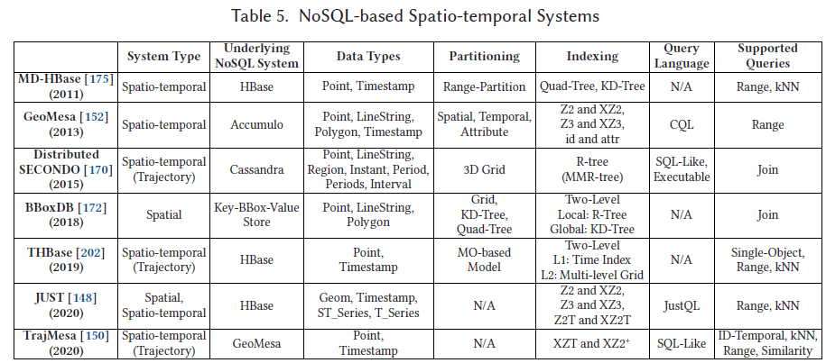
Big spatio-temporal data processing infrastructures
NoSQL based
GeoMesa linearizes the keyspace by transforming multi-dimensional data (location, timestamp) into 1D keys using space-filling curves.
JUST incorporates leverages HBase, GeoMesa, and Spark. Introduces two new indexing techniques, Z2T and XZ2T and efficient compression mechanism that improves the query performance significantly.
TrajMesa, horizontal storage schema (H-Store) is proposed. Allowing to store an entire trajectory in one-row with compression.
Recent literature
SpaceTimeDB (commercial, (?))
Springbok, ICDE 2024
CUPID, Future Generation Computer Systems 2024
TMan, ICDE 2024
Other Research Trends
ML for query optimization
Spatial Query Optimization With Learning, VLDB 2024
Indexing
A Time-Identified R-Tree: A Workload-Controllable Dynamic Spatio-Temporal Index Scheme for Streaming Processing, International Journal of Geo-Information 2024
A case study for Digital Twins
Graph + TimeSeries (Apache AGE + PostgreSQL + PostGIS + Timescale)
MobilityDB (PostgreSQL + PostGIS + trajectory data support)
Beast
CUPID
Springbok
Case study 0 - Apache Age + TimescaleDB + PostGIS
Emerged considerations
Given a FIWARE document, what’s a Property and what’s an Edge? - It’s an edge if it links to an NGSI URN
Should the graph enforce some kind of schema? E.g. metamodel - I beleve so but dunno
If not, Do I have to check wether a FIWARE key-value pair links to a node?
But then, I have to check all properties, understand if its an edge or a property, remove it from the entity if it’s an edge, check if the edge destination already exists and if it does not, create it and link it to the source node-
What about device composition? e.g. moisture grid
What about Ids? Apache AGE uses its own custom IDs that cannot be disabled
What happens when a new measurements comes by?
I have to check if such node exists, if not, it’s a new edge, if it is
An entity comes in: there’s already a node with such id; is it an update? Is it a measurement?
Modellazioni Measurement
AgriRobot non è un device, come capisco se qualcosa ha dei measurement da storicizzare?
Agri robot non storicizza le controlled property, come faccio a capire cosa devo storicizzare?
Problemi sui dati
I dati dei pinotech hanno il dateObserved sbagliato (“Z” alla fine della data)
Per creare un arco, devo prima avere entrambi i nodi altrimenti non funzia
Age Middleware
Builds a connection to a Apache Age + PostGIS + Timescale DBMSs.
Processes JSON entities following the NGSI schema.
Graph holds the last state of entities (debatable)
Timescale Table
Single TimeSeries Table
Measurement = Hypertable(timestamp, device_id, controlledProperty, value, location, raw_value)
PrimaryKey: (timestamp, device_id, controlledProperty)
R-Tree index on location
Age Middleware - Mapping
Taxonmy of NoSql based big systems for spatial data

Slide 37
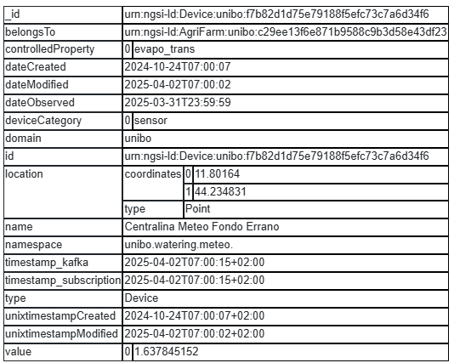
Entity required schema
id: NGSI standard (urn-ngsi-[…]); define the existence of an entity in the graph
type: defines the label of the node/edge in the graph
Entity optional schema
hasDevice: defines device composition. Each value of this key is a json representing an entity.
Fiware entity example

Slide 38
Building the graph
Each distinct entity (unique “id”) gets mapped into the graph as a node.
Each JSON key that has an NGSI ID as a value becomes an edge with the key as the edge label.
If an entity with the given “id” exists, update it in the graph
Parsing into Time-Series
One mapping for each entity “type”: function that extracts a Measurement schema from a JSON entity
Environment setup
CREATE EXTENSION IF NOT EXISTS age; CREATE EXTENSION IF NOT EXISTS postgis; LOAD ‘age’; SET search_path = ag_catalog, “$user”, public;
SELECT create_graph(‘agri_graph’);
CREATE TABLE measurements( timestamp timestamp, device_id text, controlled_property text, location geometry, value float, raw_value text ) SELECT create_hypertable(‘measurements’, ‘timestamp’);
ALTER TABLE measurement ADD PRIMARY KEY(timestamp, device_id, controlled_property)
CREATE INDEX location_index ON measurements USING GIST (location);
Schema

Slide 39
Distinct types:
AgriFarm
AgriParcel
AgriTree
Device
AgriRobot
DeviceModel
Province
Region
Task
Camera

Slide 40
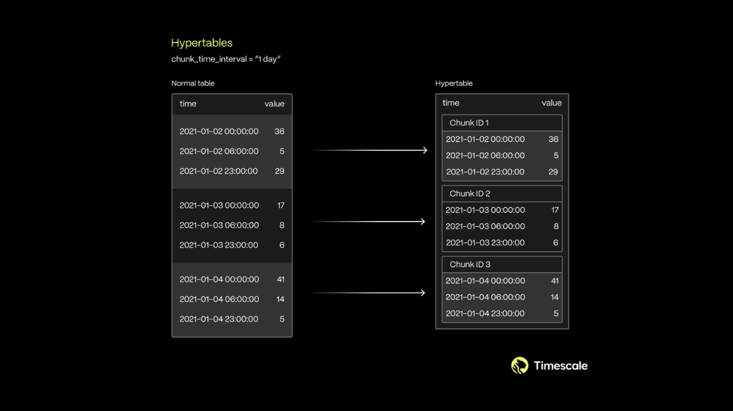
Problematiche
Tre cause delle problematiche: - Modellazione concettuale (e.g. no tipo di device in measurements) - Architetturale (Apache Age) - Ottimizzazione query (e.g. no tabella location ausiliaria)
Espressività
Mancanza di un’interfaccia uniforme sul modello, devi interfacciarti e integrare due tipologie di modelli dati diversi
No storicizzazione di ciò che non è measurement
Modellazione
Se parti dal grafo arrivi ad un punto in cui joini sul relazionale, va fatta attenzione alla query su grafo in quanto è molto facile ritorni un insieme di valori ridondanti che fanno esplodere il tempo computazionale
Cosa succede sul grafo se il nodo esiste già? Lo aggiorno, ma in che modo? Sovrascrivo il vecchio? Aggiungo le diff? E le diff in negativo vanno tolte? Cosa succede ai suoi archi? Se nella nuova versione non vedo un arco?
Random considerations (constantly updated)
TimescaleDB
Build upon a PostgreSQL instance.
Based on hypertables:
Logical table
Organizes the data in chunks (of a predefined time range) based on some time/bigint column of the table (B-Tree).
Each chunk gets mapped into a table.
Other columns can be added in partitioning columns
Support for distributed hypertables
Supports a large set of PostgreSQL extensions (e.g. PostGIS, PostGIS_Raster)
TimescaleDB - Query language
Table organization in chunks

Slide 41
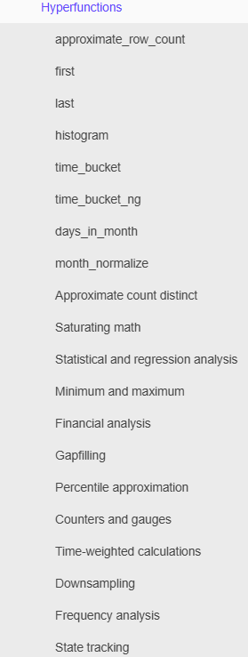
Uses standard SQL with a more operators/functions:
time_bucket(‘1 hour’, column_name): same as date_trunc in PostgreSQL but with custom granularity
…
Hyperfunctions:
Time-weighted averages;
Percentile approximation;
Hyperfunctions list

Slide 42
TimescaleDB - Further functionalities

Slide 43
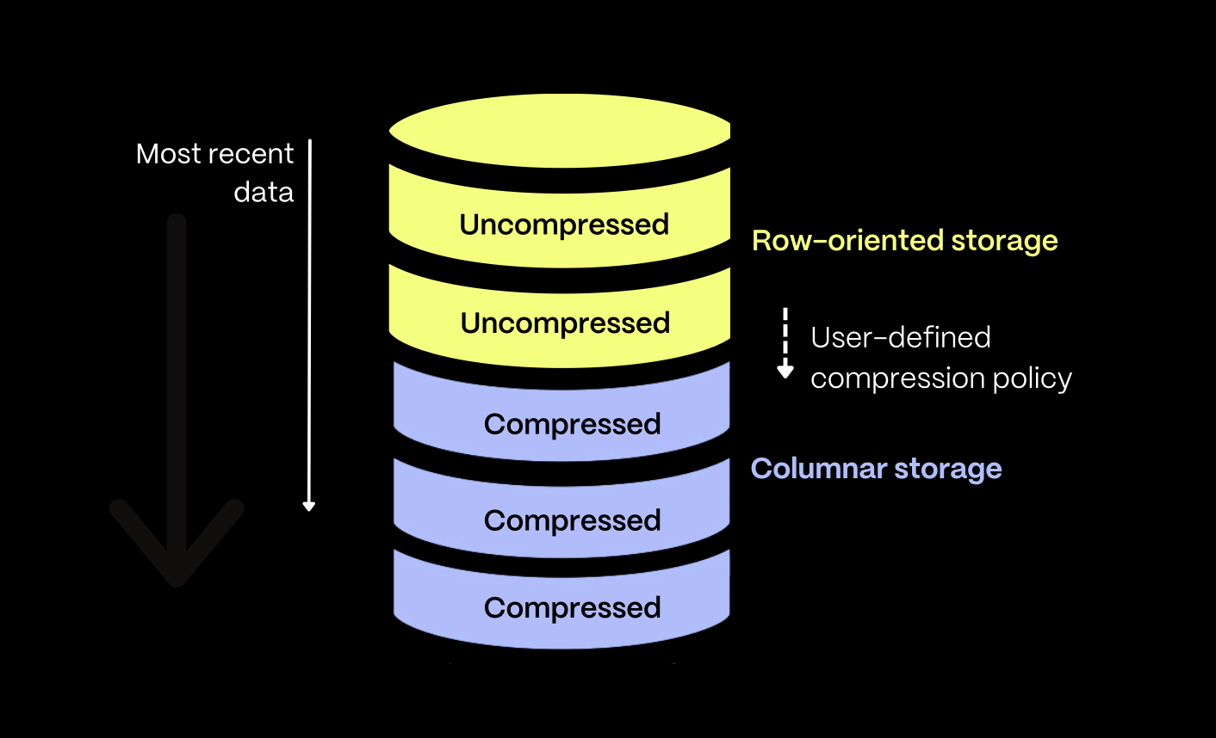
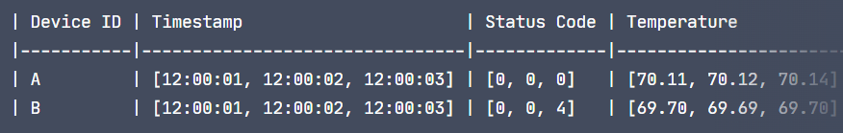
Hybrid row-column oriented data model: define a retention period where data older will be stored as column-oriented data.
Column-Oriented data can still be performed DML/DDL operations upon.
TimescaleDB - Hybrid model optimizations
segmentby: partion data inside chunk on [column1, …]
orderby: orders data within a chunk based on time and stores metadata w.r.t min/max values in the chunk (similar to Databricks data-skipping)
Together: data is first grouped by the segmentby column, then ordered based on the orderby parameter, and finally divided into smaller, timestamp-ordered “mini-batches,” each containing up to 1,000 rows.
Timescale hybrid model
Segmentby example - partition by device id

Slide 44
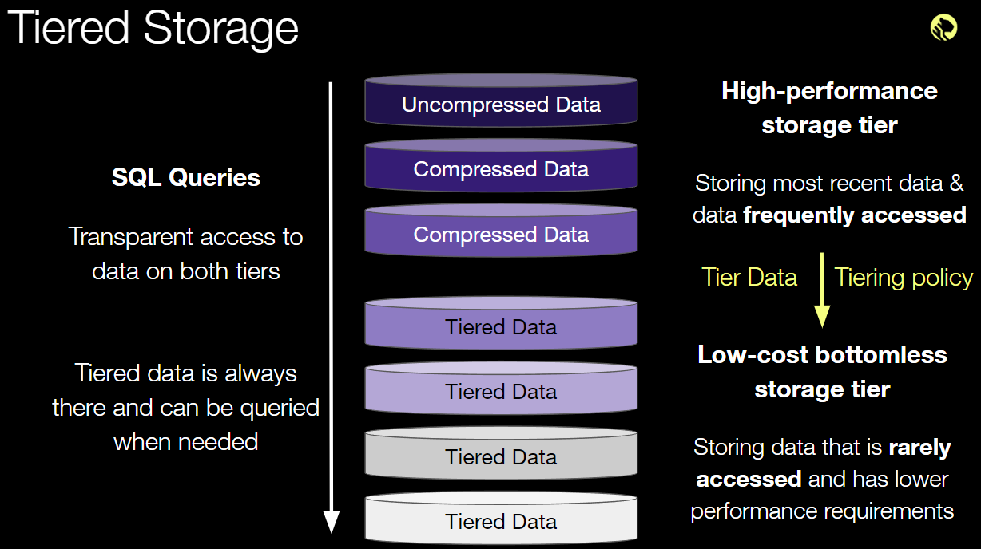
TimescaleDB - Further functionalities
Continuous aggregates
Like a continuous materialized view
Automatically (in background) maintain the results from the query.
Refreshed automatically in the background as new data is added, or old data is modified.
Tiered storage
Move least-accessed data into a different tablespace, in order to reduce the volume of data in highly-accessed data
Time Series DBMSs - InfluxDB
Not based upon the relational model (organizes data in tags and fields)
Not really CRUD db: more like a CR-ud, prioritizing the creating and reading data over update and destroy
Leverages an Log-Structured Merge Tree like data structure.
Log-Structured Merge Tree (LSM Tree)
Two storage areas: in memory and on disk.
Data is first written to an in-memory structure (MemTable, usually an AVL tree), then moved to disk in batches in form of immutable SSTables (Sorted String Table).
Each SSTable gets a correspective sparse-index file (usually kept in-memory) that describes the keys and the offset in the table they can be found.
Whenever a given level is full, data is compressed and reorganized into the following level
Out-of-Place Updates and Deletes: updates and deletes are handled as new inserts, and are applied lazily.
Tiered architecture example

Slide 45
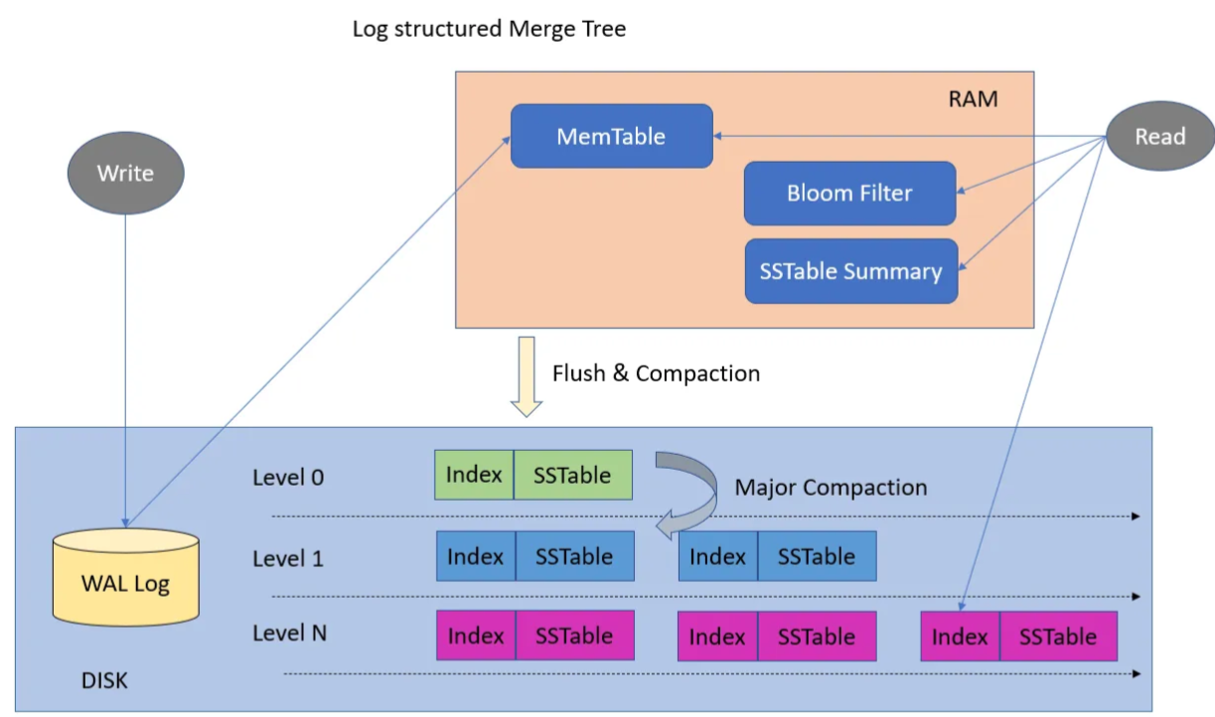
MemTable: in-memory temporary sorting area. As it fills up, its contents are flushed to disk in a batch of sorted data structures called Sorted String Tables (SSTables).
Sorted String Tables (SSTables): They store key-value data in sorted order (by key), enabling efficient queries and range scans. Each SSTable represents a snapshot of data at a specific point in time.
Levels: SSTables are organized into levels. Lower levels contain more recent data, while higher levels store compacted data.
Writing data in a LSM tree

Slide 46
LSM Tree - Merging and Compaction

Slide 47
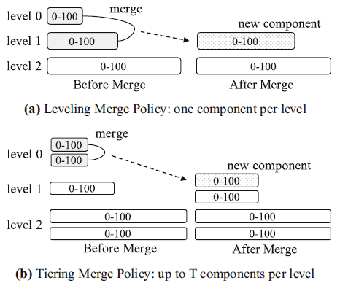
Two main policies, both organize disk components into logical levels (or tiers):
Tiering merge: maintains up to T components per level:
When level L is full, its T components are merged into a new component at level L + 1;
Better write performance;
Leveling merge: fixed size level, each level only maintains one sorted component, components are constantly merged to avoid key overlaps between components:
Component at level L is T times larger than the component at level L − 1;
Component at level L will be merged multiple times with incoming components at level L − 1;
When it fills up, it will then be mergedinto level L + 1;
Better read performance;
Higher write amplification;
Most common.
Example of merging techniques

Slide 48
LSM Tree - Merging v.2
The two main merge paradigms considered are stack-based and leveled. In stack-based policies, components are organized as a stack, where the most recent components are higher in the stack. Leveled policies use (almost) fixedsize components, with newer components on higher levels; lower levels have more components per level. Stack-based LSM trees usually have better write performance and good read performance. Leveled LSM tree is the most popular paradigm in the industry with very good read performance, but higher write amplification in general
LSM Tree - Pro & Cons
Pro
Efficient for write-heavy workloads by minimizing the number of disk writes.
High throughput;
High level of compression;
Cons
Poor read performances on random accesses on small chunks of data (bloom filters are used to mitigate);
Requires constant merging and compression (resource wise);
Read amplification;
Write amplification, specifically bad for SSDs.
Optimizations
Optimizing interactions with hardware (e..g., NVMEs SSDs);
Compaction algorithms;
Partitioning: range-partition the disk components (SSTables) of LSM-trees into multiple (usually fixed-size) small partitions.
LSM Tree - Partitioning

Slide 49
Breaks a large component merge operation into multiple smaller ones.
To merge an SSTable from level L into level L + 1:
all overlapping SSTables at level L + 1 are selected;
then merged with it to produce new SSTables still at level L + 1
Could be applied to tiered merge policy;
However, each level can contain multiple SSTables with overlapping key ranges.
Pro
Reduces time, resources and disk utilization during merging
For skewed updates, the merge frequency of the components with cold update ranges can be greatly reduced.

Slide 50
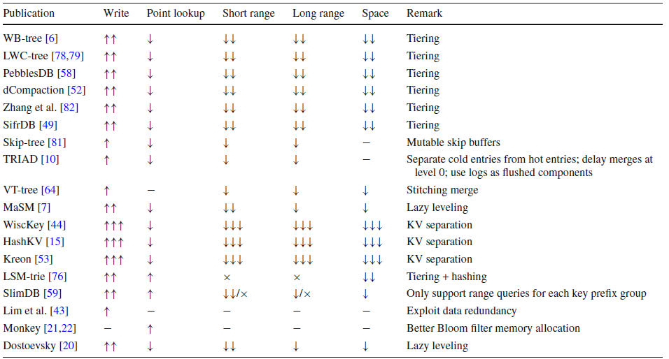
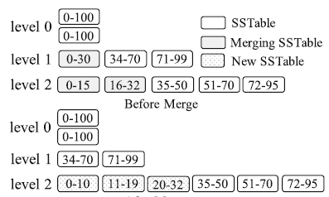
LSM Tree - Evolutions
A lot of LSM-tree based data structure have been proposed, playing with the trade-offs offered by the native implementation.
Partitioning example
Considerations on LSM based variants

Slide 51
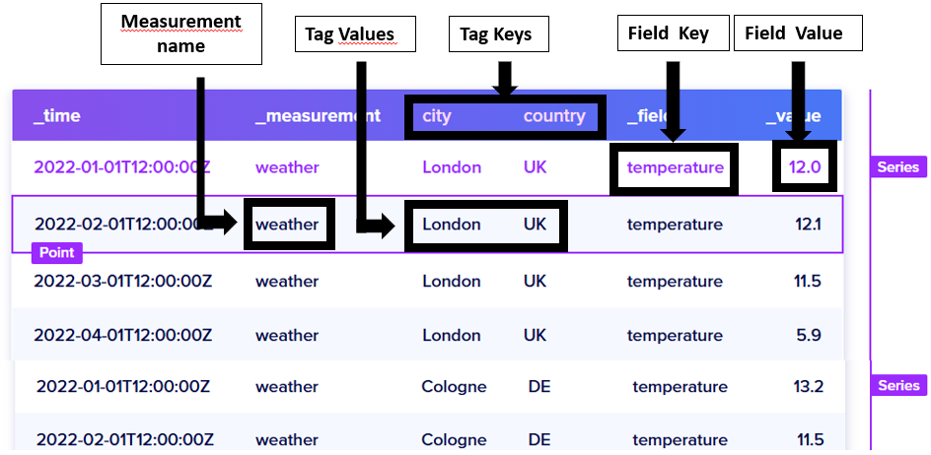
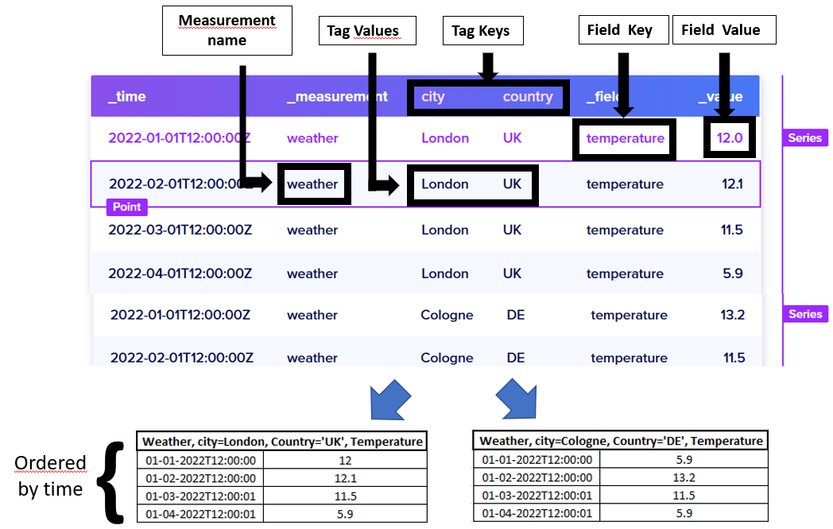
InfluxDB
InfluxDB - Data Model
Bucket: Named location where time series data is stored. A bucket can contain multiple measurements.
Measurement: Logical grouping for time series data. Points in a given measurement share the tags. A measurement contains multiple tags and fields.
Tags: Key-value pairs with values that differ, but do not change often. Tags are meant for storing metadata for each point–for example, something to identify the source of the data like host, location, station, etc.
Fields: Key-value pairs with values that change over time–for example: temperature, pressure, stock price, etc.
Timestamp: Timestamp associated with the data. When stored on disk and queried, all data is ordered by time.
Point: Single data record identified by its measurement, tag keys, tag values, field key, and timestamp.
Series: A group of points with the same measurement, tag keys, and tag values.
InfluxDB - Storage Engine
Writes and retrieves data from disk; four components:
Write Ahead Log (WAL): retains data when storage engine restarts. Ensures data is durable in case of unexpected failure.
Cache: in-memory copy of data points currently stored in the WAL.
Organizes points by key (measurement, tag set, and unique field)
Gets queried at runtime and merged with the data stored in Time Structured Merge (.tsm) files
Time Structured Merge Tree (.tsm) files
Time Structured Index (.tsi) files
Each write requests follows:
Is appended to the end of the WAL file;
The write request is stored in an in-memory cache and data is sorted by key (measurement name, tag set and unique field key).
Once cache’s size is above a threshold, a snapshot is taken and saved as .tsm file. Corresponding WAL entries are removed
.tsi files are created with a similar procedure WAL + cache.
InfluxDB - Time Structured Merge Tree (TSM)
Specialization of a Log-Structured Merge Tree
Stores each series data in a columnar format
To improve efficiency, the storage engine only stores differences (or deltas) between values in a series.
Series: A group of points with the same measurement, tag keys, and tag values.
InfluxDB - Time Structured Merge Index (TSI)
InfluxDB - Query language
Flux: non-SQL-like syntax
InfluxQL: SQL-like but with less operatiors (e.g. no UNION, JOIN and HAVING)
Timescale vs. InfluxDB
Schema variability: while on a TimescaleDB table schema has to be defined upfront (can’t add dimensions to a non-empty table), InfluxDB is much more flexible
SQL JOINs aren’t available for InfluxDB measurements in InfluxQL, they are with Flux. doc
Overall
Timeseries DBMS (TSDBMS) are optimized for temporal data, each TSDBMS follows its own philosophy.
Very-High frequency of writes
Most read queries are range-scan queries;
Very few/none update/delete operations.
Focus on data compression (!! since volumes easily become in the order of PB, and since most queries focus on recent data), e.g. retention policies
Focus on opimizations, e.g. data-skipping, downsampling, user-defined-functions (e.g. hyperfunctions in Timescale)
InfluxDB data model
InfluxDB TSM organization

Slide 52
Neo4j
Neo4j - Data layout
Leverages index-free adjacency: bidirectional joins are precomputed and stored in the database as relationships, as opposed to RDBMS where joins need to be materialized during query time via foreign keys.
Data organized in store files:
nodes;
relationships;
labels;
properties.
Neo4j - Nodes and Relationships
Each entity is assigned an ID.
Fixed sized records, allowing fast lookups (node_id:100, its record begins at 100*9 bytes).
Relationships are doubly linked list.
A relationship “belongs” to two nodes.

Slide 53
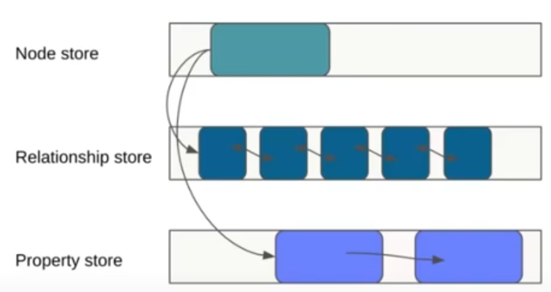
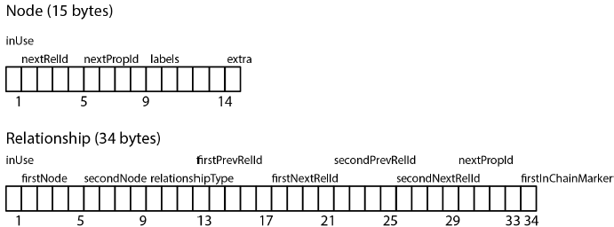
Neo4j nodes and relationships storage
Example of Neo4j storage

Slide 54
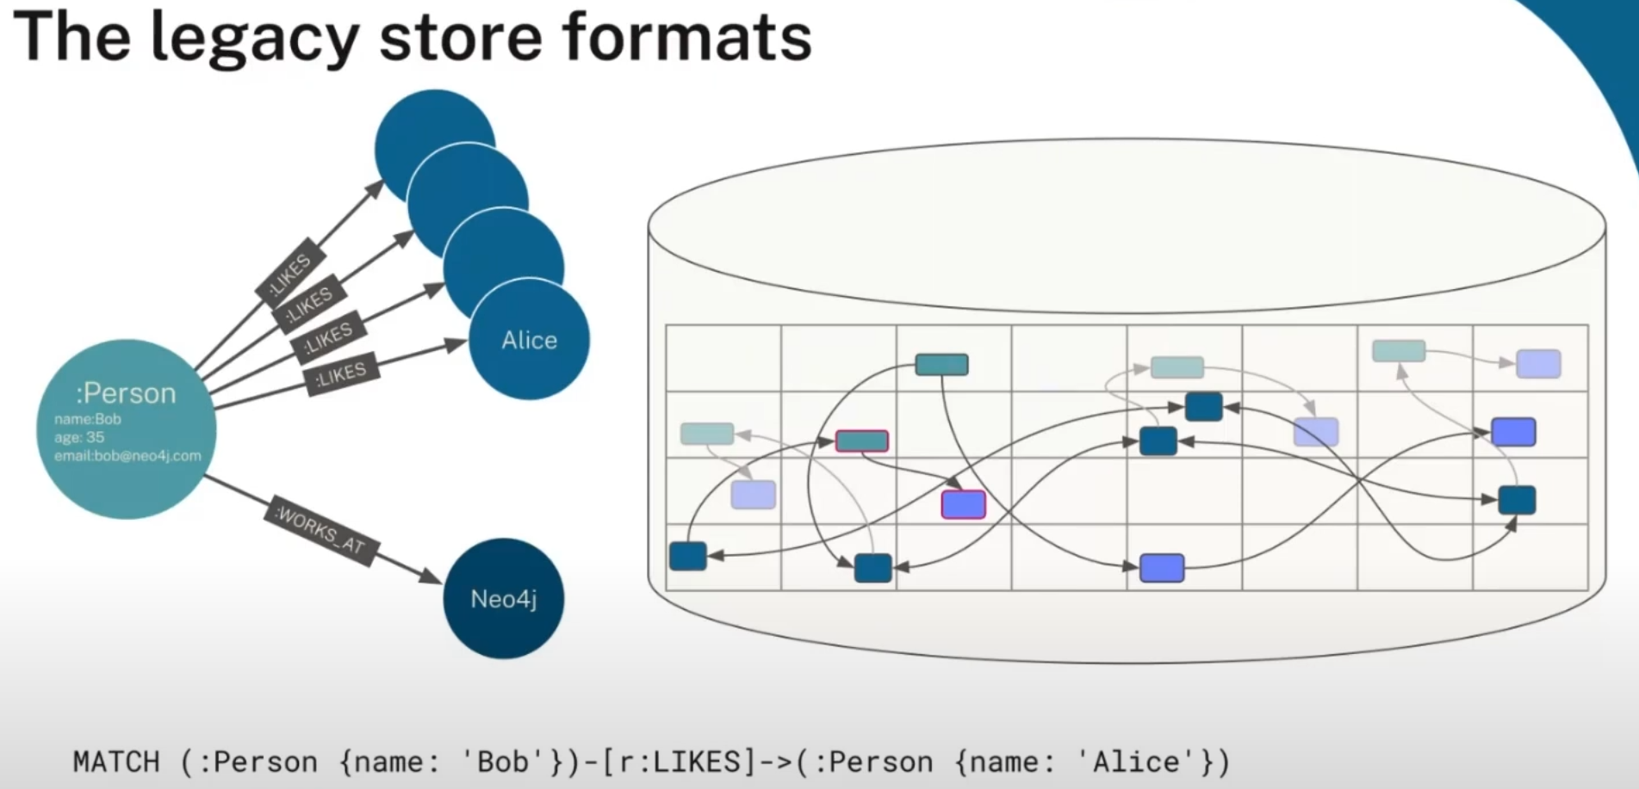
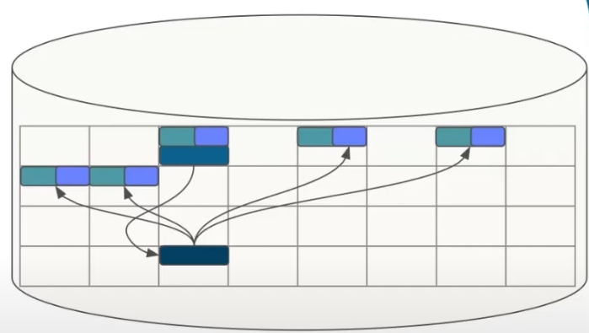
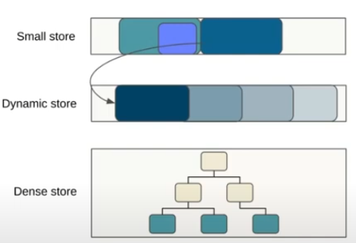
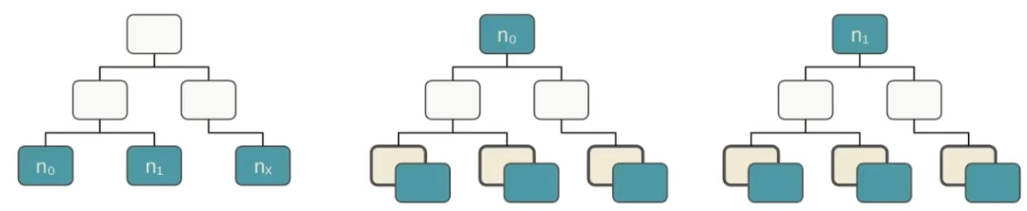
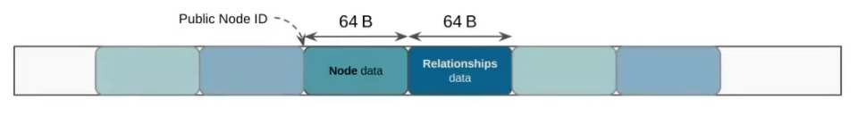
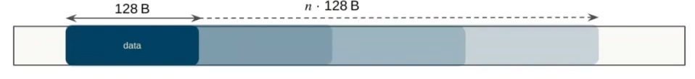
Neo4j - Legacy Format
Data spread multiple files, in different records;
Accessing data can cause multiple page faults;
Performance deegrades over time as data turns fragmented;
Performance degrades quickly when ratio of store size to pagecache increases;
When page fault occurs, need to access data on disk.
Neo4j - Block Format
Available ATM only in Neo4j enterprise edition;
Leverages data co-location: graph local-data is stored together on disk;
Organizes data in three storage: small store, dynamic store and dense store;
Data is organized w.r.t. its size.
Neo4j block format - Small store
In most dataset, the majority of nodes fit in this layout
Up to 10 labels/properties and 5 relationships
Static 128 B blocks
64B Node data: labels and properties
64B Relationships data: relationships and properties
But not all nodes fit in this store…
Neo4j block format - Dynamic store
Grows and shrinks in units of 128B blocks
Two different stores for nodes and relationships
Dynamic node store:
Up to 8192 B records;
Used when labels/properties exceed small store capacity.
Dynamic relationship store:
Up to 2048 B records;
Used when relations exceed small store capacity;
or node has at least one dense relationship type.
But a node might have thousands or milions of relationships…
Neo4j block format - Dense store
Based on multi-root generational B+Tree
Dense relationship store
Separate root for each node
Effectively a map of {this node, type, direction, other node} -> properties
Used when relationships of a type exceed the dynamic store capacity
Neo4j block format - Key improvements
Fast queries: Fewer disk/memory accesses.
More memory efficient: Data colocations means performance gains; fewer pages need to be loaded -> fewer page faults -> fewer I/O operations
Faster property access: Properties inlined with nodes/relationships
Neo4j - Community Edition
Open source version of Neo4j
Aligned data layout
No info whatsoever available anywhere
Nice considerations
In addition to the organization of the local index discussed above, which determines how data is organized in a single LSM component (file), another key design choice for spatial LSM indexes is the merge policy, which determines when and how components are merged. The
Example of Neo4j legacy format access pattern
Example of Neo4j block format
Neo4j small store
Neo4j dynamic store
Neo4j dense store
Accessing block format

Slide 55
AsterixDB
AsterixDB - Introduction
Distributed LSM-based DBMS
Hash-partitioning on primary key
Secondary indexes are node-local
Run in parallel
Retrieve a set of PKs
JSON based data model (ADM)
Asterix Query Language (AQL) as query language
AsterixDB stores information about the field defined a priori as separate metadata; information about fields that are ”just there” in instances of open Datatypes is stored within each instance.
AsterixDB - Data Model
Dataverse: akin to a DB in RDBMS; place to create and manage Datatypes and Datasets
Datatype: specifies what its definer wants AsterixDB to know, a priori, about a kind of data that it will be asked to store.
Closed Datatype:prevents users from storing objects with extra or illegally missing data.
Open Datatype: instances are allowed to have additional content, beyond what the type specifies
Dataset: stored collection of data instances of a Datatype
Data is stored (and indexed) as a B+-Tree keyed on primary key

Slide 56
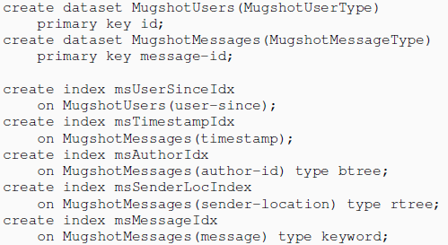
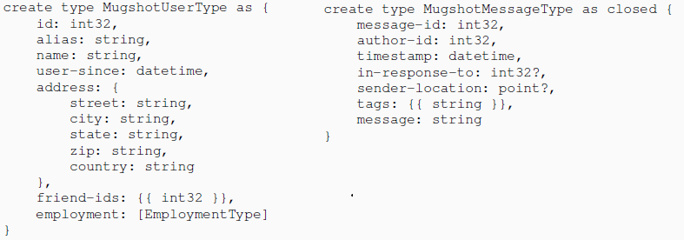
AsterixDB Datatype example
AsterixDB Dataset example

Slide 57

Comparison | AsterixDB | RocksDB
Stats | None | None
Compaction | focus on managing updates | key-based
Partitioning | Hash-partitioning | None
Queries | SQL-Like | KV DBMS
Workload balancing | Native (hash-partitioning on keys) | None
AsterixDB - Internals
Secondary indexes are standard LSM-ified indexes (e.g. LSM-B+Tree)
Given its LSM-based representation, big focus on handling updates and granting ACID properties (record-level consistency)
The final state of insertion, flushing, then deletion applied to a secondary LSM R-tree and a secondary LSM B+-Tree. Both indexes are storing entries of the form <SK; PKi> where SK is a secondary key and PK is the associated primary key. The LSM R-tree handles deletion by inserting the primary keys of the deleted entries in its deleted-key B+-tree, while the LSM B+-tree handles it by inserting a control entry, denoted by <SK;PKi> into its memory component.
RocksDB vs. AsterixDB
Example of secondary LSM B+-Tree and LSM R-tree

Slide 58
AsterixDB - Deploy
git clone https://github.com/ManuelePasini/asterixdb.git cd asterixdb
Install maven if not present
sudo apt install maven
Install jdk21
sudo apt install openjdk-21-jdk -y sudo update-alternatives --config java
Build AsterixDB
mvn clean package -DskipTests
Run AsterixDB
cd asterixdb/asterixdb/asterix-server/target/apache-asterixdb-0.9.10-SNAPSHOT // Deploy node controller bin/asterixncservice > red-service.log 2>&1 & // Deploy cluster controller bin/asterixcc -config-file opt/local/conf/cc.conf > cc.log 2>&1 &l
Kill AsterixDB
ps aux | grep asterix | grep -v grep | awk '{print $2}' | xargs kill -9
AsterixDB - Measurements dataverse setup
drop dataverse Measurements_Dataverse if exists; create dataverse Measurements_Dataverse; use Measurements_Dataverse; create type PunctualMeasurement as closed { meas_id: string, // device_id + meas_type + timestamp timestamp: datetime, device_id: string, controlled_property: string, `value`: int, location: point }; create type SpatialMasurement as closed { meas_id: string, // device_id + meas_type + timestamp dateObserved: datetime, device_id: string, controlled_property: string, `value`: int, location: polygon }; create dataset Measurements(PunctualMeasurement) primary key meas_id; create index meas_location on Measurements(location) type rtree;
AsterixDB - Open measurements setup

Slide 59
create type PunctualOpenMeasurement as open { meas_id: string, timestamp: datetime, device_id: string, controlled_property: string, `value`: int, location: point }; CREATE DATASET OpenMeasurements(Measurement)IF NOT EXISTS primary key id; create index measurement_location on OpenMeasurements(location) type rtree;
CREATE TYPE NodeRelationship AS CLOSED { id: int, `type`: string, toN: bigint, fromNextRel: int?, toNextRel: int? };

Slide 60
1 Dataset
//meas_id = device_id + meas_type + timestamp use Measurements_Dataverse; create dataset OpenMeasurements(PunctuaOpenMeasurement) primary key meas_id; create index meas_location on OpenMeasurements(location) type rtree;
1 Dataset x Device
//meas_id = meas_type + timestamp use Measurements_Dataverse; create dataset {Dev_id}_OpenMeasurements(PunctuaOpenMeasurement) primary key meas_id; create index meas_location on OpenMeasurements(location) type rtree;

Slide 61

AsterixDB - Device Measurement
Se metto tutto in un tabellone è una merda in lettura perchè devo, al netto di filtrare su t4imestamp e location, filtrare su una regex della chiave per prendere solamente quel tipo di ts.
Posso pushare sotto la tsId come attributo per fare un match secco, oppure portare giù anche i singoli attributi che compongono la chiave, ma è ridontante…
DROP dataverse Measurements_Dataverse IF EXISTS; CREATE DATAVERSE Measurements_Dataverse; USE Measurements_Dataverse;
CREATE TYPE PropertyValue AS OPEN { stringValue: string?, doubleValue: double?, intValue: int? };
CREATE TYPE Property AS CLOSED { id: int, sourceId: bigint, sourceType: Boolean, key: string, value: PropertyValue, type: int, fromTimestamp: DATETIME?, toTimestamp: DATETIME? };
CREATE TYPE NodeRelationship AS CLOSED { id: int, type: string, fromN: bigint, toN: bigint, fromNextRel: int?, toNextRel: int?, fromTimestamp: DATETIME?, toTimestamp: DATETIME?, nextProp: int?, properties: [Property]? };
CREATE TYPE Measurement AS OPEN { id: STRING, timestamp: DATETIME, nextRel: int?, nextProp: int?, property: STRING, location: geometry, relationships: [NodeRelationship], properties: [Property] fromTimestamp: DATETIME, toTimestamp: DATETIME, value: FLOAT };
CREATE DATASET OpenMeasurements(Measurement)IF NOT EXISTS primary key id; create index measurement_location on OpenMeasurements(location) type rtree;
Temporal graphs
Three basic approaches:
Duration-labeled temporal graphs (DLTG<) : edges are labeled with a value representing the duration of the relationship between two nodes
Interval-labeled temporal graphs (ILTG): each edge is a temporal edge representing a relationship from a vertex u to another vertex v, valid during a time interval $I=\left[t_{Z}Zs,t_{e}\right]$.
Snapshot-based temporal graphs (SBTG): A temporal graph $G\left[t_{i},t_{j}\right]$ in a time interval $\left[t_{i},t_{j}\right]$, is a sequence {$G_{t_{i}},G_{t_{i}+1},...,G_{t_{j}}$} of graph snapshots.

Slide 62
Temporal graphs
Clock-G @ ICDE 2022
AeonG @ VLDB, 2024
introduces two temporal syntax extensions in the MATCH clause:
Time-Point queries: FOR TT AS OF 𝑡 , which retrieves all graph objects legal at time 𝑡
Time-Slice queries: FOR TT FROM 𝑡1 TO 𝑡2, which locates all graph objects consistently legal within the time range from 𝑡1 to 𝑡2.
T-GQL @ VLDB Journal, 2023
A collection of operators for computing different kinds of temporal paths in a graph, capturing different temporal path semantics.
:::: {.columns}
Temporal graphs
Clock-G
Evaluating DTGraph

Slide 63
Competitors:
AeonG @ VLDB 2024
HyGraph, Workshop @ EDBT 2025
PostgreSQL + Apache AGE + TimescaleDB + PostGIS
Dataset:
SmartBench @ VLDB 2020
Agritech (?)
Competitor | Layout | In-Memory | Spatial | Time-Series | Historical-Graph | Scale-out
AeonG | Graph | No | No | No | Yes | No
HyGraph | Graph | Yes | No | Yes | Yes | No
PostgreSQL + Age + Timescale + PostGIS | Relational | No | Yes | Yes | No | No
Us | Graph + WideColumn | No | Yes | Yes | Yes | Yes

Slide 64
Evaluating DTGraph - Configuration

Slide 65

Ingestion
Volume: big data [1, 10, 100] GB
Cluster Machines: [1, 2, 4] slaves
Data Sources: [1, 10, 100]
Mode: [offline, online]
Storage
Storage consumption for the WHOLE dataset (replication=1)
AeonG evaluation setup

Slide 66
Query workload

Slide 67
Parameters
Elapsed time
Query aspects
Predicate pushdown:
Filter predicates (normal + spatial)
Aggregation predicates (group by attributes)
Join between TS
Historical queries on graph

Slide 68
Evaluatin DTGraph - Queries
EnvironmentCoverage(L, 𝜏) (Q2), where L is a list of locations, and 𝜏 is a measurement type: lists all agents that can generate measurements of a given type 𝜏 that cancover the environments/locations specified in L.
EnvironmentAggregate(𝜖, 𝜏, 𝑡𝑎, 𝑡𝑏 ): where 𝜖 is anenvironment. List, for each agent in the environment 𝜖 during the period [𝑡𝑎, 𝑡𝑏 [, the average hourly value of type 𝜏 during the period [𝑡𝑎, 𝑡𝑏 [.
MaintenanceOwners: MaintenanceOwners(𝜏, alpha): List all owners of devices that measured took measurements of type 𝜏 above a threshold alpha during the period [𝑡𝑎, 𝑡𝑏 [
EnvironmentAlert(𝐴): List the environments that have had a temperature > 20 degrees during the period [𝑡𝑎, 𝑡𝑏 [.
AgentOutlier: List the max value measured for each agent in each environment
AgentHistory(𝐴): where 𝐴 is a set of agents. For each 𝛼 ∈ 𝐴, list all environments 𝜖 for which 𝛼 generated measurements in.
(Q1) Coverage(s): returns the coverage of a given sensor s.
(Q3) Observations(s, 𝜏, tb, te): selects observations from a sensor during the time range [𝑡𝑎; 𝑡𝑏].
(Q4) Observations(S in Sensors, tb, te): selects observations from sensors in the list of sensors S during the time range [𝑡𝑎b; 𝑡𝑏].
(Q5) C_Observations(𝜏 , cond, tb, te): selects observations generated by sensors of given type in the time range [𝑡𝑎; te] that satisfy the condition cond
(Q6) Statistics(S in Sensors, A, F, tb, te): retrieves statistics (e.g., average) based on functions specified in F during the time range [tb; te]
Evaluating DTGraph - SmartBenchmark

Slide 69
Small
3197 verticles
5467 edges
8442 properties
8 Time-Series
207 370 measurements (only observations, no semantic observation)
Total ingestion time: 10 326 ms
Measurements ingestion time: 9861 ms
AsterixDB Storage Size (primary index + spatial R-Tree index): ~ 130 MB
Large
6237 verticles
12 442 edges
15 698 properties
200 Time-Series
10 368 001 measurements (only observations, no semantic observation)
Total ingestion time: ~ 462 486 ms
Measurements ingestion time: 461 886 ms
AsterixDB Storage Size (primary index + spatial R-Tree index): ~ 1.8 GB

Slide 70
Big
Considerations
Come modellare AeonG: 1 nodo per ts con update pppure n nodi per n measurements
Loro per un update fanno search + update su base di un id, io mi tengo in memoria in fase di caricanento gli is dei grafi e faccio le operazioni a basso livello con gli id dei nodi, non scala con grafi abnormi. Inoltre, la cosa è semplice per un arco perché fai la search dei due nodi, ma per un measurement? Devo per forza fare un search basato sulla semantica: sensore, property (che è il nodo ts), quindi non cerco più nemmeno due nodi, ma devo cercare un path se non faccio come ho fatto ora; è una sorta di caching. Forse ha senso definire delle api (tipo socket, in cui inserisci sulla tua stessa macchina per il grafo e ip:porta sui node controller per le ts, in questo modo parallelizzi ulteriormente) per facilitare l’inserimento?
Io faccio del parsing semantico: il parsing fa parte dell’ingestion? Tipo la data, ha un formato standard? Se si, posso aspettarmi di ricevere i dati già pronti? Oppure la data deve esssre nel formato uscito da quel dataset? Se ho smeanricaC posso associare ad una serie di property il fatto che siano edge? Oppure devo rimanere generico e definirlo a livello di struttura del json come ho fatto {id:x}
Io seguirei lo standard NGSI o addirittura NGSI-LD in modo da fissare la sintassi. Anche perché così non devo storpiare il dataset da aggregate-oriented a graph oriented e devo solo farlo aderire allo standard
La parte di creazione TS di un dataset che è molto lenta perchè richiede query HTTP eventualmente iterate, fa parte dell’ingestion o possiamo assumere di avere già un dataset x ts e direttamente pushare i dati (sempre creando la parte di grafo)
Virtual Sensor

